Slide 1

Movie Time
Ashley Nguyen
Holly Miesbauer

Slide 2


What influences movie popularity?
How long it runs?
How much money it earned?
Are certain genres more popular than others?

Slide 3
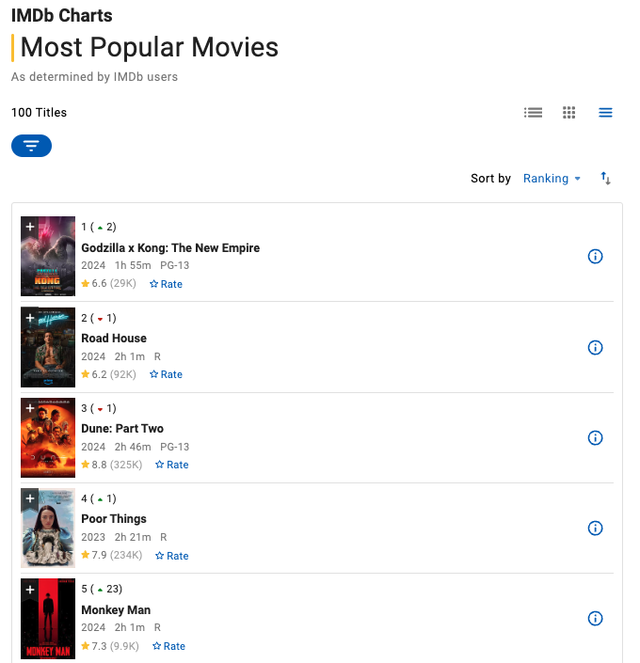
Webscrape from IMBD Charts
Gathered top 100 most popular movies

Slide 4
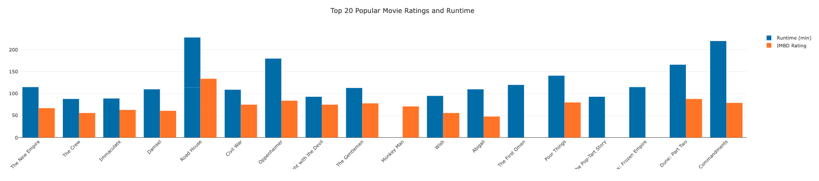
Does runtime effect movie popularity?

Slide 5
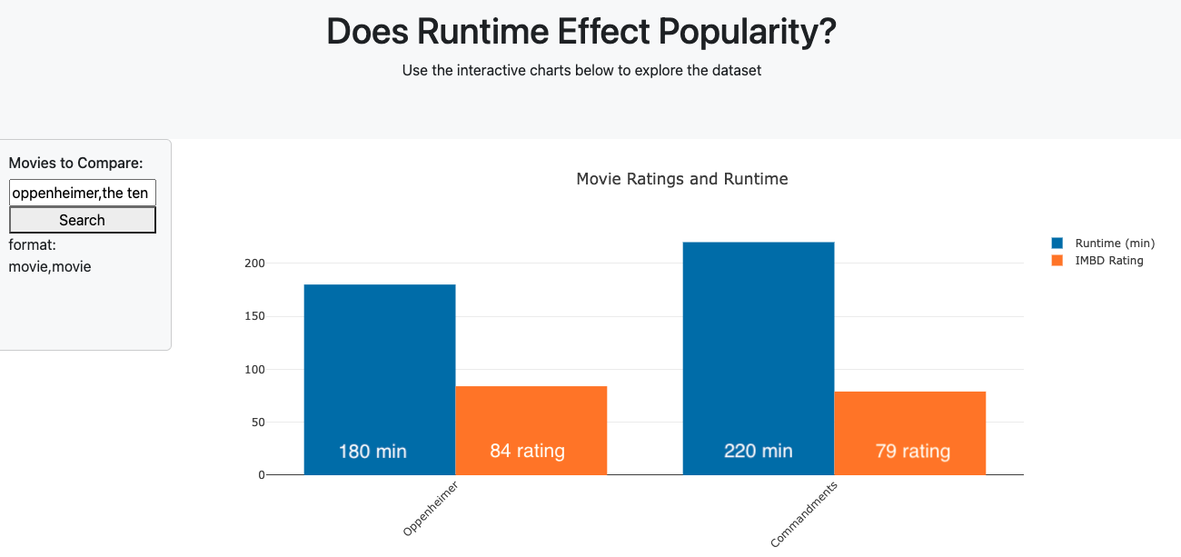
Are longer movies more popular?
Longest runtime from top 20 popular movies
Longer runtime resulted in lower IMBD rating
Worth the time? Longer runtime negative, unless good rating
Long enough to tell a story in an engaging way (screendaily)

Slide 6
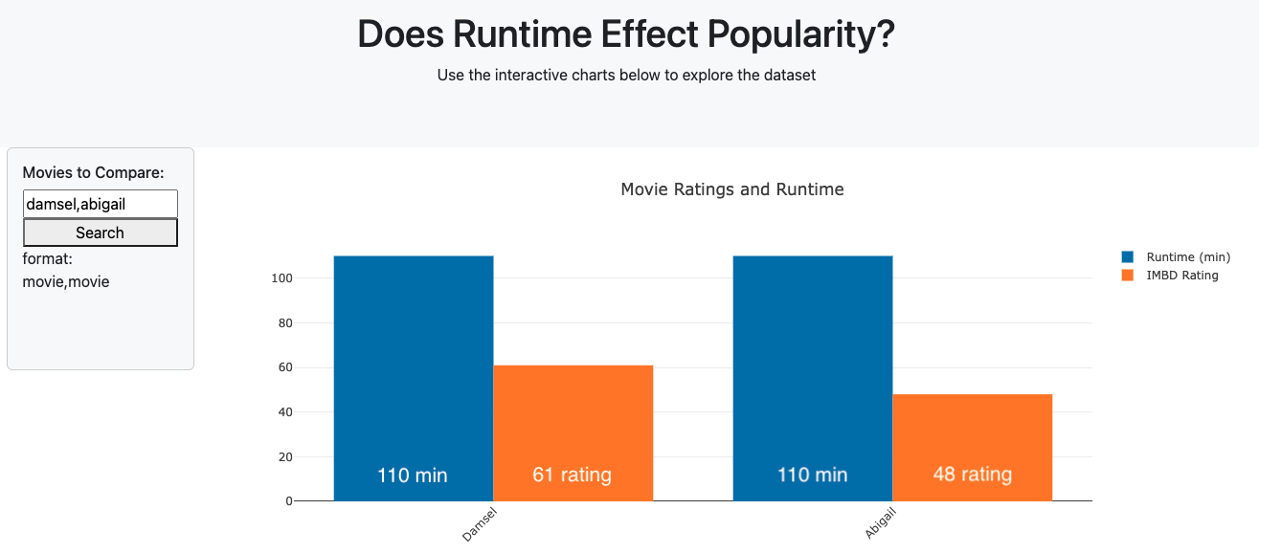
Same Runtime, Differing Popularity
Ages 18-55+ preferred runtimes of 91-120 minutes
45% of sample
(statistica)
Both movies have preferred runtime but differing rating (other factors?)

Slide 7
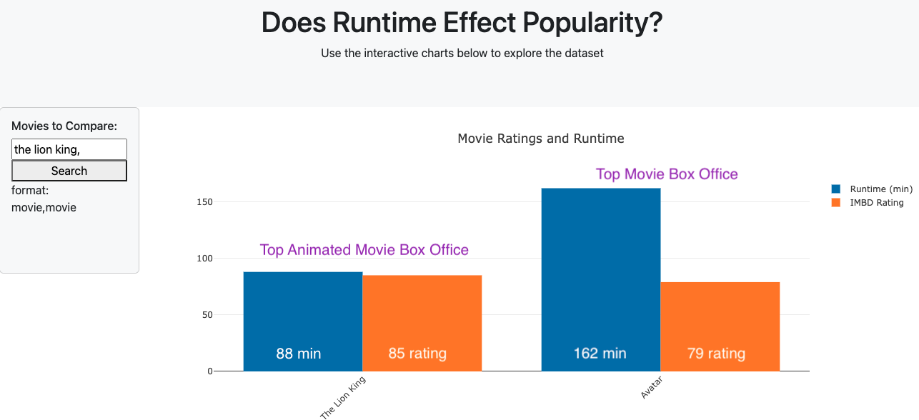
Does runtime have any other dependencies?
Huge difference in runtime, but similar popularity
Age dependency?
Adults have longer attention spans vs children
Keep children engaged or will be bored
(woombie)

Slide 8
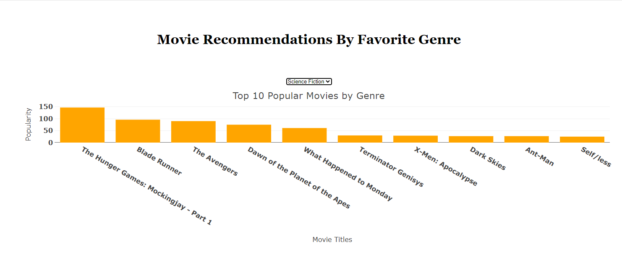
Are certain movie genres more popular than others?

Slide 9
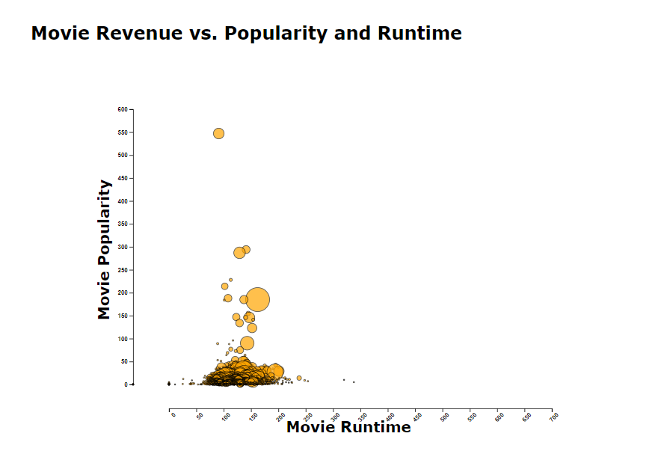
Are higher grossing movies more popular?

Slide 10
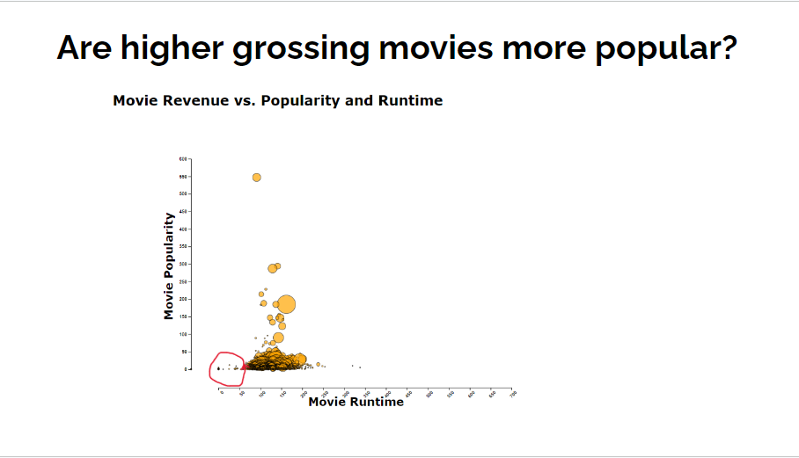
Are higher grossing movies more popular?

Slide 11
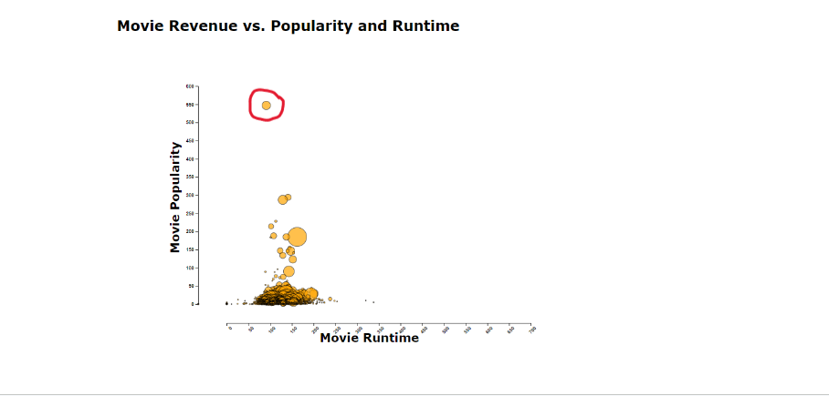
Are higher grossing movies more popular?

Slide 12
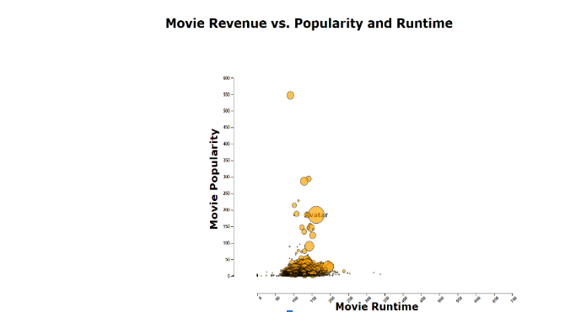
Are higher grossing movies more popular?
Notes:
Interacting with the Bubble Chart. Mouse hover over the revenue circles reveals the title of the movie.
While the team was proficient in using visualization tools such as Leaflet and Plotly prior to this project. For this project in particular, the team chose to learn visualizations with D3.js in particular due to customization options like mouse hover text as well as the comprehensive tutorials and documentation available for visualizations with D3.js.
New library learned d3.js Why? Customization options like animations, colors, comprehensive tutorials and documentation.
https://observablehq.com/@d3/scatterplot-tour?intent=fork
https://d3js.org/getting-started#try-d3-online

Slide 13
What the data shows
Runtime vs. popularity
90 -120 minutes
Popular movie genres
Hidden Gems
Overall popularity
Bubble Chart
Provides insight but not causality

